Slide 1

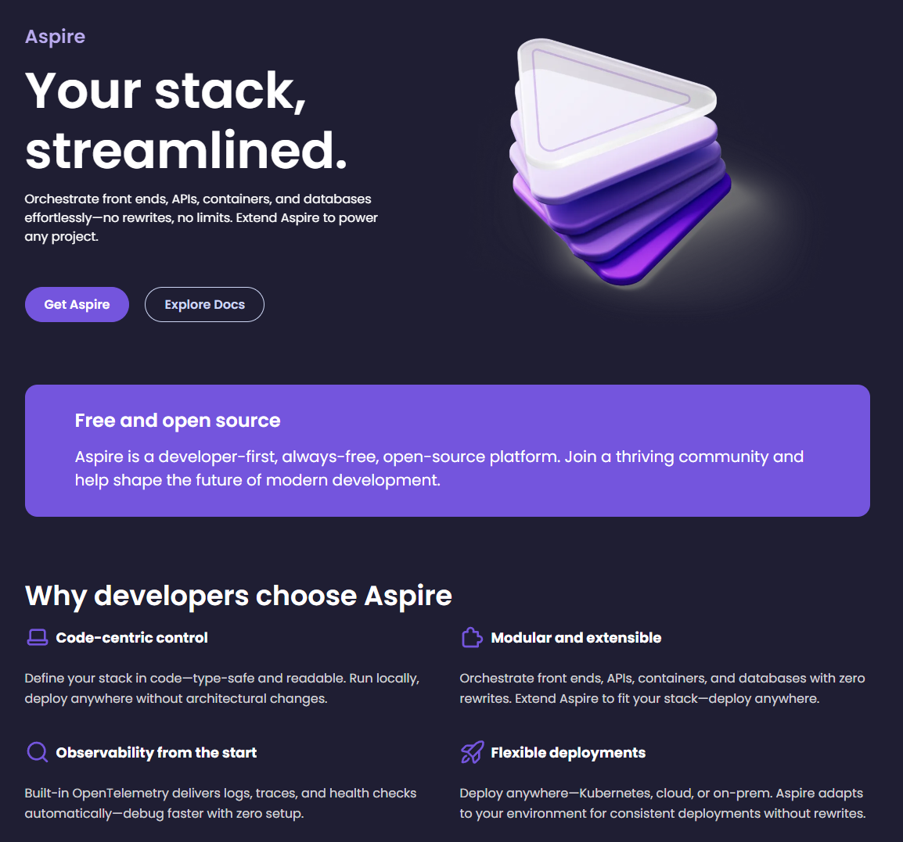

Aspire
Microsoft’s unified toolchain for building applications

Slide 2
Agenda
What is Aspire?
Why use Aspire?
Deployment
Other orchestration tooling
Demo time 🕺

Slide 3
What is Aspire?
“Aspire provides tools, templates, and packages for building observable, production-ready distributed apps. At the center is the app model—a code-first, single source of truth that defines your app's services, resources, and connections.”
Toolchain
Inner development loop
Orchestration and integrations
Notes:
Code first (C#) orchestration tussen applicaties en services
Makkelijk en snel kunnen developen
Leunt op container runtime (e.g. Docker/Podman)

Slide 4
Why use Aspire?
Orchestration through code
IDE integration
Never again “works on my machine” ☺
Observability
Community-driven
Open-source
Notes:
Snel kunnen developen lokaal
Makkelijk en zonder connectionstrings en dergelijke
C#
Eenvoudig en overzichtelijk

Slide 5
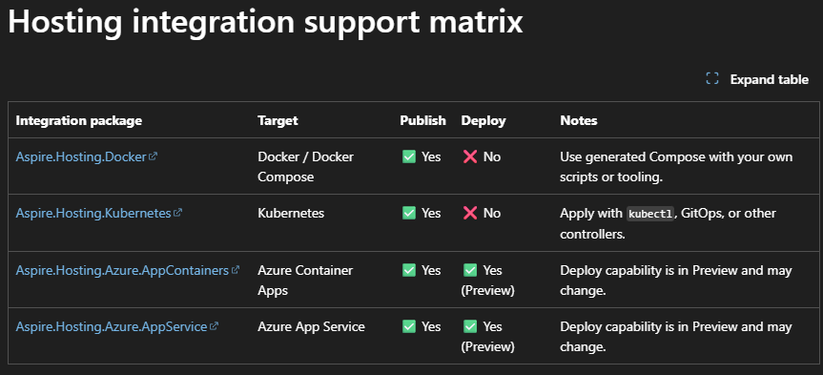
Deployment
Built-in support in preview
publish & deploy
Notes:
Aspire CLI nodig
Publish genereert halffabrikaten (artfacts met werk nodig)
Deploy doet een hands-off deploy naar Azure
Alles is te customizen
Deploy is interactive by default en doet eerst publish

Slide 6
Other orchestration tooling
Docker Compose
Kubernetes
Dapr

Slide 7
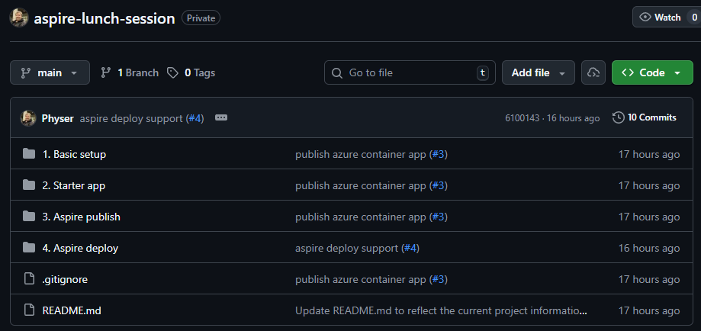

Slide 8

Physer/aspire-lunch-session

Slide 9
References
Aspire homepage - https://aspire.dev/
Microsoft Learn’s Aspire documentation - https://learn.microsoft.com/en-us/dotnet/aspire/get-started/aspire-overview
Aspire’s FAQ - https://learn.microsoft.com/en-us/dotnet/aspire/reference/aspire-faq
Github repository - https://github.com/Physer/aspire-lunch-session

